Slide 1
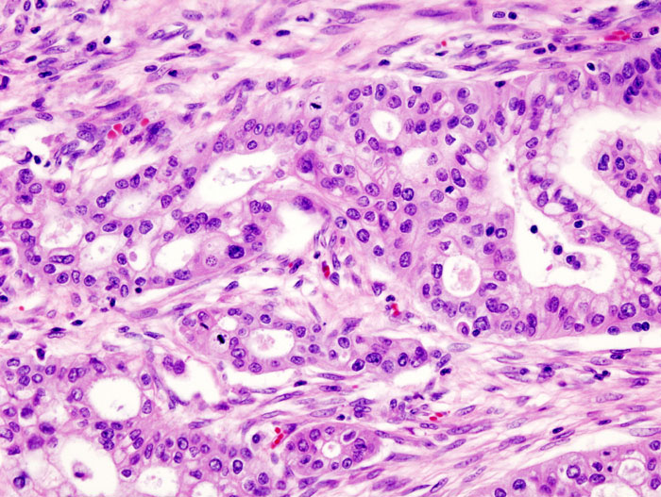
SPATIAL TRANSCRIPTOMICS RESEARCH
Spatial Transcriptomics & Multimodal Metastatic Biomarker Discovery
Progress Report
Research Advisors: Dr. Ashiq Masood & Dr. Mohsin Bilal
Date: 25th June 2026
PDAC LIVER METASTASIS PREDICTION

Slide 2
Presentation Overview
1
2
3
4
5
Background & Objectives
Dataset & Cohort
Phase A: Tri-Modal
Phase B: Metastatic
Validation & Next
Clinical problem, research goals, framework overview
Patient mapping, QC findings, data inventory
CLIP-style architecture, retrieval results
4 modules, direction scoring, GAT smoothing
Heatmap results, open questions, action items
This progress report covers the tri-modal deep learning framework for predicting liver-specific metastasis in PDAC. We present Phase A (contrastive learning) and Phase B (metastatic signature detection) results, clinical validation heatmaps, and open questions requiring discussion.

Slide 3
PART 01
Clinical Motivation & Research Framework
Project Background & Objectives
The clinical bottleneck in PDAC management and our computational approach to address it
* This section establishes the clinical problem and defines the research objectives driving the framework design

Slide 4
Clinical Problem & Research Motivation
04
The Clinical Bottleneck
Our Approach
PDAC's aggressive metastatic tropism to the liver is the primary barrier to effective clinical management. Current approaches face critical limitations:
● Spatial transcriptomics provides exceptional sub-cellular maps but is costly and tissue-destructive
● Lack of infrastructure prevents routine hospital deployment of ST technologies
● Standard H&E slides are widely available but underutilized for predictive biomarker discovery
A non-destructive multi-modal distillation framework that:
● Trains on ST + scRNA-seq + H&E during development
● Learns to map morphology to molecular state
● Deploys on standard H&E only at inference - no sequencing needed
30 Visium Slides
20,395 Spots
17,893 Genes
15 Cell Types
Across 13 patients
Total tissue spots analyzed
Gene expression panel
RCTD deconvolution
Core Hypothesis: Structural microenvironmental signatures in H&E slides like cellular density variations, invasive front architectures, ECM remodeling corridors contain predictive information about liver metastatic propensity decodable through multi-modal deep learning.

Slide 5
Immediate Action Items & Timeline
28
STREAM 1
STREAM 2
STREAM 3
Code Refactoring
Data Verification
Cohort Acquisition
● Implement non-bottleneck Pc architecture
Current: 15→128→64→256
Target: 15→64→128→256
● Update to log-transformed temperatures
self.log_tau instead of inline clamping
● Re-run Phase A training
Validate no regression in retrieval
Timeline: 1-2 weeks
● Confirm data filteration
Confirm 0% mito is expected
● Inspect raw counts for CDKN2A
Check all spots + synonyms
● Document filtering pipeline
For reproducibility and methods
Timeline: Ongoing
● Request 16 missing WSI images
Patients 2, 6, 8, 9, 10, 12
● Ensure 40x BIGTIFF format
Pyramidal, tiled, JPEG
● Update patient tracking matrix
Resolve inconsistencies
Timeline: TBD (needs approval)
All three streams can proceed in parallel. Stream 1 is internal and can start immediately. Streams 2 and 3 need external coordination and your guidance.

Slide 6
Thank You
Discussion & Questions
Spatial Transcriptomics Research | June 2026

